Slide 1
Introduction to Java, and DrJava part 1
Barb Ericson
Georgia Institute of Technology
May 2006

Slide 2
Learning Goals
Understand at a conceptual level
  What can computers do?
  What is DrJava?
  How do you do math and relational operations in Java?
  What is casting and why might you need it?
  What are Java primitive types and how do they work?
  What are the order of math operations in Java?
    How can you change them?

Slide 3
What Can Computers Do?
Basically they can
  Add, subtract, multiply, divide
  Compare values
  Move data
They are amazingly fast
  Millions to billions of instructions per second
They can store a huge amount of data
  Entire movies, photo albums, dictionaries, encyclopedias, complex games
They keep getting faster, cheaper, and smaller

Slide 4
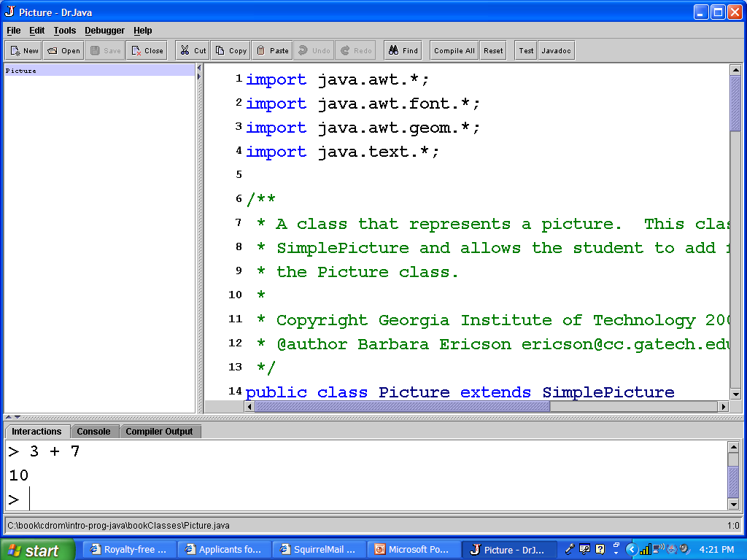
What is DrJava?
DrJava is a free integrated development environment for doing Java programming
  From Rice University
  It is written in Java
It has several window panes in it
  For creating programs (definitions pane)
  For trying out Java code (interactions pane)
  Listing of open files (files pane)
Notes:
The pane that shows the code (on the right) is called the definitions pane.
The pane that allows you to type Java expressions and see the result is called the interactions pane.

Slide 5
Math Operators in Java (+ * / - %)
Addition
  3 + 4
Multiplication
  3 * 4
Division
  3 / 4
Subtraction
  3 – 4
Negation
  -4
Modulo (Remainder)
  10 % 2 and 11 % 2
Notes:
The compiler interprets 3.0 as a double (floating point number) and 3 and 4 as integers. The result of an operation is in the same type as the values being operated on so the result of 3 / 4 is 0 since and integer can’t represent 0.75.
See http://java.sun.com/docs/books/tutorial/java/nutsandbolts/arithmetic.html for arithmetic operators in the Java tutorial

Slide 6
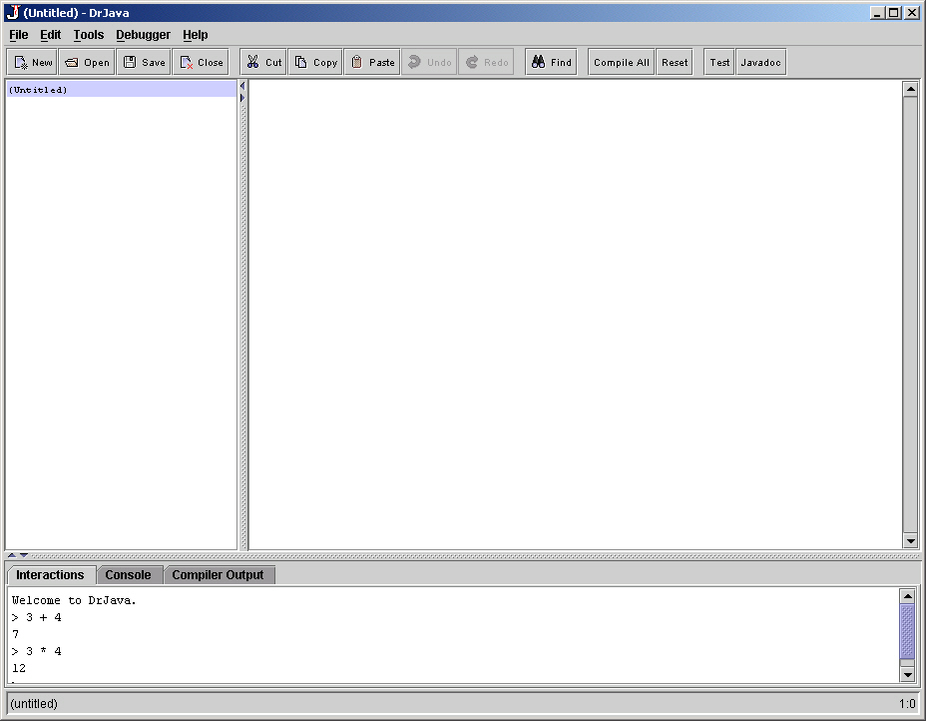
Math Operators Exercise
Open DrJava and do the following in the interactions pane
  Subtract 7 from 9
  Add 7 to 3
  Divide 3 by 2
  Divide 4.6 by 2
  Multiply 5 by 10
  Find the remainder when you divide 10 by 3
Notes:
To open DrJava double click on the DrJava icon. You will see a small window which will show while it loads. It can take a few minutes to load.

Slide 7
Why is the result of 3 / 2 = 1?
Java is a strongly typed language
  Each value has a type associated with it
  Tells the computer how to interpret the number
    It is an integer, floating point, letter, etc
The compiler determines the type if it isn’t specified (literals)
  3 is an integer
  3.0 is a floating point number (has a fractional part)
The result of an operation is in the same type as the operands
  3 and 2 are integers so the answer is an integer 1

Slide 8
Casting
There are other ways to solve the problem of 3 / 2 has a result of 1
You can make one of the values floating point by adding .0
  3.0 / 2
  3 / 2.0
The result type will then be floating point
Or you can cast one of the values to the primitive types: float or double
  (double) 3 / 2
  3 / (float) 2
Notes:
Floating point means that the number is stored in two parts. The digits are stored (without the period) and the location of the period is stored as a power of 10.

Slide 9
Casting Exercise
Use casting to get the values right for splitting up a bill for 3 people of 19 dollars.
Try it first with a calculator
Try it in DrJava without casting
Try it in DrJava with casting

Slide 10
Java Primitive Types
  Integers (numbers without fractional parts) are represented by
    The types: int or short or long
    235, -2, 33992093, etc
  Floating point numbers (numbers with fractional parts) are represented by
    The types: double or float
    3.233038983 -423.9, etc
  A single character is represented by
    The type: char
    ‘a’ ‘b’ ‘A’ etc
  True and false values are represented by
    The type: boolean
    true or false
Notes:
The primitive types in Java are not objects. Java left some simple data types as primitives to speed computation.

Slide 11
Why so Many Different Types?
They take up different amounts of space
They have different precisions
Usually use int, double, and boolean
  byte uses 8 bits (1 byte) 2’s compliment
  short uses 16 bits (2 bytes) 2’s compliment
  int uses 32 bits (4 bytes) 2’s compliment
  long uses 64 bits (8 bytes) 2’s compliment
  float uses 32 bits (4 bytes) IEEE 754
  double uses 64 bits (8 bytes) IEEE 754
  char uses 16 bits (2 bytes) Unicode format
Notes:
A floating-point type (float or double) stores both the digits and the exponent.
See http://www.petebecker.com/js200006.html for more information on floating-point numbers.

Slide 12
Sizes of Primitive Types
byte
8 bits
short
8 bits
8 bits
int
8 bits
8 bits
8 bits
8 bits
long
8 bits
8 bits
8 bits
8 bits
8 bits
8 bits
8 bits
8 bits
float
8 bits
8 bits
8 bits
8 bits
double
8 bits
8 bits
8 bits
8 bits
8 bits
8 bits
8 bits
8 bits
char
8 bits
8 bits

Slide 13
Types Exercise
Which type(s) take up the most space?
Which type(s) take up the least space?
What type would you use for
  The number of people in your family
  A grade
  The price of an item
  The answer to do you have insurance
  The number of people in the class
  The number of people in your school
  The number of people in your state

Slide 14
Floating Point Numbers
Numbers with a fractional part
  6170.20389
Stored as binary numbers in scientific notation -52.202 is -.52202 x 10²
  The sign (1 bit)
  The digits in the number (mantissa)
  The exponent (8 bits)
Two types
  float – 6-7 significant digits accuracy
  double – 14-15 significant digits accuracy
Notes:
The mantissa is stored in positive binary. The exponent is stored as positive binary but with the addition of the stored value to -126 for float and -1023 for a double. So an exponent value of 0 for a float is actually an exponent of -126.
See http://www.javaworld.com/javaworld/jw-10-1996/jw-10-hood.html for more information.

Slide 15
Comparison (Relational) Operators
Greater than >
  4 > 3 is true
  3 > 3 is false
  3 > 4 is false
Less than <
  2 < 3 is true
  3 < 2 is false
Equal ==
  3 == 3 is true
  3 == 4 is false
Not equal !=
  3 != 4 is true
  3 != 3 is false
Greater than or equal >=
  3 >= 4 is true
  3 >= 3 is true
  2 >= 4 is false
Less than or equal <=
  2 <= 3 is true
  2 <= 2 is true
  4 <= 2 is false
Notes:
The symbol ‘=‘ does not test for equal in Java. It is used as an assignment statement.
See http://java.sun.com/docs/books/tutorial/java/nutsandbolts/relational.html for the Java tutorial section on relational operators.

Slide 16
Comparison Operators Exercise
In DrJava
  Try out the comparison operators in the interactions pane
    with numbers
      3 < 4
      4 <= 4
      5 < 4
      6 == 6.0
    with characters (single alphabet letter)
      Put single quote around a character
      ‘a’ < ‘b’
      ‘b’ < ‘a’
      ‘a’ == ‘a’
Notes:
Characters are represented as numbers with letters that we think of as coming first in alphabetizing schemes having lower numbers than the later letters.

Slide 17
Operator Order
The default evaluation order is
  Negation -
  Multiplication *
  Division /
  Modulo (remainder) %
  Addition +
  Subtraction -
The default order can be changed
  By using parenthesis
  (3 + 4) * 2 versus 3 + 4 * 2

Slide 18
Math Operator Order Exercise
Try 2 + 3 * 4 + 5
Add parentheses to make it clear what is happening first
How do you change it so that 2 + 3 happens first?
How do you change it so that it multiplies the result of 2 + 3 and the result of 4 + 5?
Notes:
In DrJava expressions entered into the interactions pane are evaluated and the result is displayed on the next line.
For more information on DrJava see http://www.drjava.org/.

Slide 19
Summary
Computers
  Can do math
  Can execute billions of instructions per second
  Keep getting faster, smaller, and cheaper
Java has typical math and relational operators
Java is a strongly typed language
  This can lead to odd results
    integer division gives a integer result
  You can use casting to solve this
Java has primitive types to represent integer and floating point numbers
Math operations have a default order
  You can specify the order with parentheses

